Slide 1

Fertility Trends and Their Correlation with GDP per Capita
A Study by Mustafa Habibi
October 2023

Slide 2


Slide 3
Abstract
This study explores the intricate relationship between age-specific fertility rates and GDP per capita across diverse nations from 1960 to 2021. Using meticulous data preprocessing and K-means clustering, it categorizes countries into three clusters, revealing a global trend of declining fertility rates, particularly in economically affluent nations. The findings underscore the complex interplay between socio-economic factors and fertility trends. The study features visual analyses of mean fertility rate trends by cluster and countries sorted by GDP, shedding light on the evolving demographic landscape.

Slide 4
Introduction
Keywords
Fertility, GDP per Capita, Age-Specific Fertility Rates, Demographics, Socio-Economic Factors, Population Trends, Unsupervised Learning, K-means Clustering.
High fertility rates in developing or economically disadvantaged countries and low fertility rates in wealthier nations have long been recognized as significant demographic trends.

Slide 5
General Characteristics
Project Objectives
The overarching goal of this study is to unravel the relationship between age-specific fertility rates and GDP per capita across different countries.
The study investigates global fertility trends and their correlation with GDP per capita, focusing on age-specific fertility rates spanning ages 15 to 49.

Slide 6
Data Sources and Preprocessing
The project draws upon data from reliable sources, including Population.UN and ourworldindata.org.
Methodology
The project employs a multifaceted approach that combines statistical methods with machine learning techniques.

Slide 7
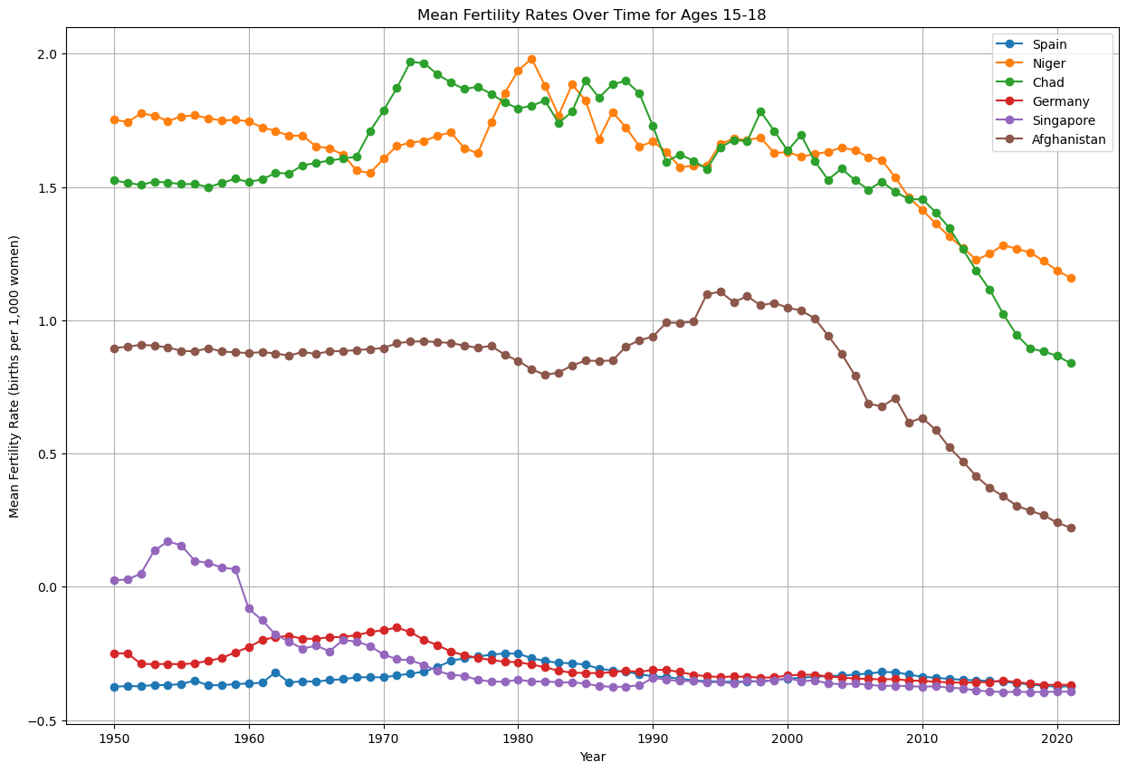
Prevalence of Child Marriage by Region

Slide 8

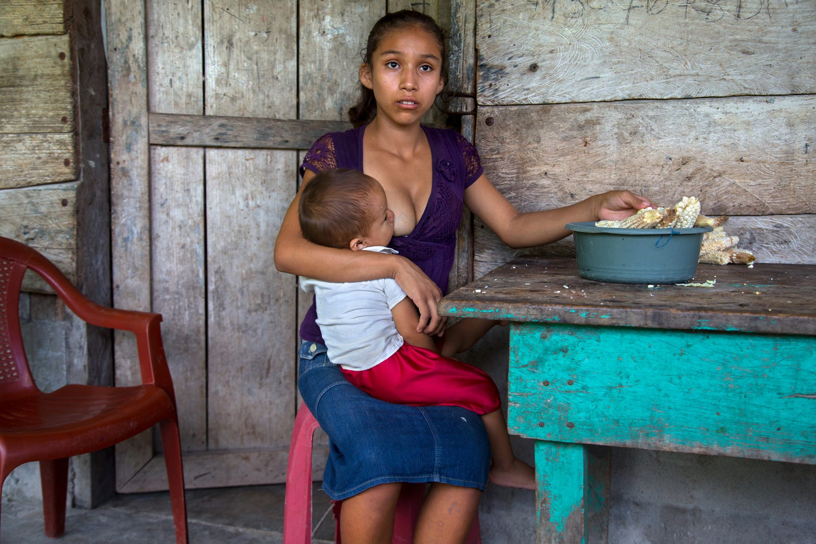
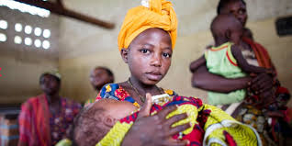
Child Marriage: A Socioeconomic Impact: Child marriage is a human rights
violation driven by factors such as poverty, social norms, and weak legal
frameworks, impacting girls and boys. International conventions address this issue, emphasizing the importance of a minimum marriage age and informed consent.

Slide 9
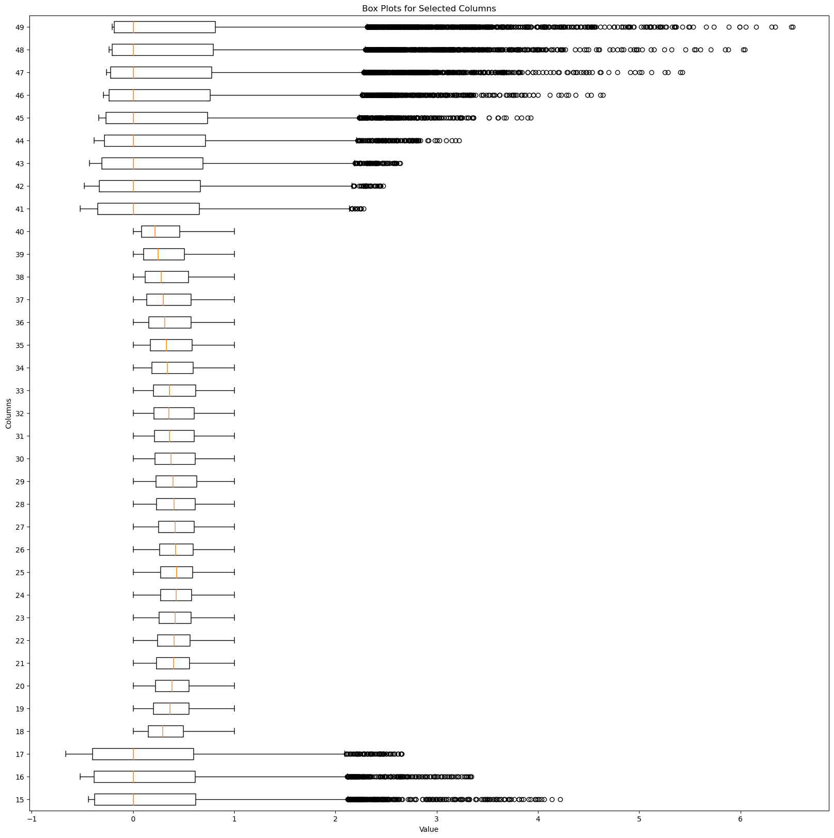
There is approximately a 50% decrease in the fertility rate of unselected women attempting pregnancy at age 40 or older compared with younger women and a two to three fold increased rate of spontaneous abortion.

Slide 10
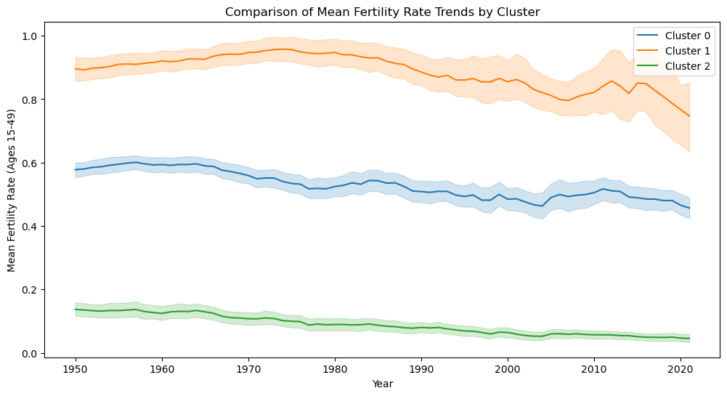
Comparison of Mean Fertility Rate Trends by Cluster

Slide 11
Cluster 0
Burundi Comoros Djibouti Eritrea Ethiopia Kenya Madagascar Malawi Mayotte Mozambique Rwanda Uganda United Republic of Tanzania Zambia Zimbabwe Angola Cameroon | Gambia Ghana Guinea Guinea-Bissau Liberia Mali Mauritania Nigeria Senegal Sierra Leone Togo Afghanistan Pakistan Lao People's Democratic Republic Timor-Leste | Central African Republic Chad Congo Democratic Republic of the Congo Equatorial Guinea Gabon Sao Tome and Principe Sudan Western Sahara Eswatini Lesotho Namibia Benin Burkina Faso Cabo Verde Côte d'Ivoire | Iraq Saudi Arabia State of Palestine Syrian Arab Republic Yemen Haiti Guatemala Honduras Bolivia (Plurinational State of) Papua New Guinea Solomon Islands Vanuatu Micronesia (Fed. States of) Samoa Tokelau Tonga

Slide 12
Cluster 1
Burundi Eritrea Ethiopia Malawi Mozambique Somalia South Sudan Uganda Timor-Leste Yemen | Equatorial Guinea Sudan Burkina Faso Gambia Guinea Guinea-Bissau Liberia Mali Mauritania Niger | Angola Central African Republic Chad Democratic Republic of the Congo Nigeria Sierra Leone Afghanistan

Slide 13
Cluster 2
Djibouti Kenya Mauritius Réunion Rwanda Seychelles Zimbabwe Gabon Sao Tome and Principe Algeria Egypt Libya Morocco Tunisia Western Sahara Botswana Eswatini Lesotho Namibia South Africa Cabo Verde Saint Helena Kazakhstan Kyrgyzstan Tajikistan Turkmenistan Uzbekistan China China, Hong Kong SAR China, Macao SAR China, Taiwan Province of China Dem. People's Republic of Korea Japan Mongolia Republic of Korea United Kingdom Albania Andorra Panama Nicaragua | Azerbaijan Bahrain Cyprus Georgia Iraq Israel Jordan Kuwait Lebanon Oman Qatar Saudi Arabia State of Palestine Syrian Arab Republic Türkiye United Arab Emirates Belarus Bulgaria Czechia Hungary Poland Republic of Moldova Romania Russian Federation Slovakia Ukraine Denmark Estonia Faroe Islands Finland Guernsey Iceland Ireland Isle of Man Jersey Latvia Lithuania Norway Sweden Mexico | France Germany Liechtenstein Luxembourg Monaco Netherlands Switzerland Anguilla Antigua and Barbuda Aruba Bahamas Barbados Bonaire, Sint Eustatius and Saba British Virgin Islands Cayman Islands Cuba Curaçao Dominica Dominican Republic Grenada Guadeloupe Haiti Jamaica Martinique Montserrat Puerto Rico Saint Barthélemy Saint Kitts and Nevis Saint Lucia Saint Martin (French part) Saint Vincent and the Grenadines Sint Maarten (Dutch part) Trinidad and Tobago Turks and Caicos Islands United States Virgin Islands Belize Costa Rica El Salvador Guatemala Honduras | Bangladesh Bhutan India Iran (Islamic Republic of) Maldives Nepal Pakistan Sri Lanka Brunei Darussalam Cambodia Indonesia Lao People's Democratic Republic Malaysia Myanmar Philippines Singapore Thailand Timor-Leste Viet Nam Armenia Italy Kosovo (under UNSC res. 1244) Malta Montenegro North Macedonia Portugal San Marino Serbia Slovenia Spain Austria Belgium Tonga Tuvalu Wallis and Futuna Islands Bosnia and Herzegovina Croatia Gibraltar Greece | Argentina Bolivia (Plurinational State of) Brazil Chile Colombia Ecuador Falkland Islands (Malvinas) French Guiana Guyana Paraguay Peru Suriname Uruguay Venezuela (Bolivarian Republic of) Bermuda Canada Greenland Saint Pierre and Miquelon United States of America Australia New Zealand Fiji New Caledonia Papua New Guinea Solomon Islands Vanuatu Guam Kiribati Marshall Islands Micronesia (Fed. States of) Nauru Northern Mariana Islands Palau American Samoa Cook Islands French Polynesia Niue Samoa Tokelau

Slide 14
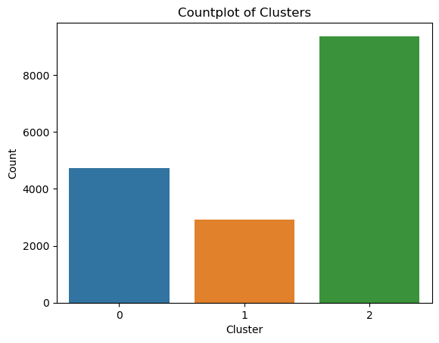
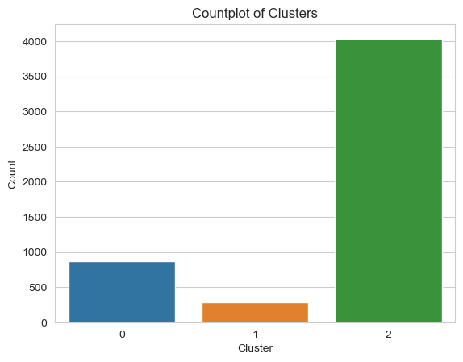
Silhouette Score: 0.3
Silhouette Score: 0.49
The Silhouette Score of 0.49 indicates the quality and appropriateness of the clusters formed through the K-means clustering analysis. A score close to 1 signifies well-separated and distinct clusters, while a score near 0 suggests overlapping clusters. In this context, a score of 0.49 suggests that the clusters have a moderate level of separation, indicating a reasonable grouping of data points based on their characteristics.

Slide 15
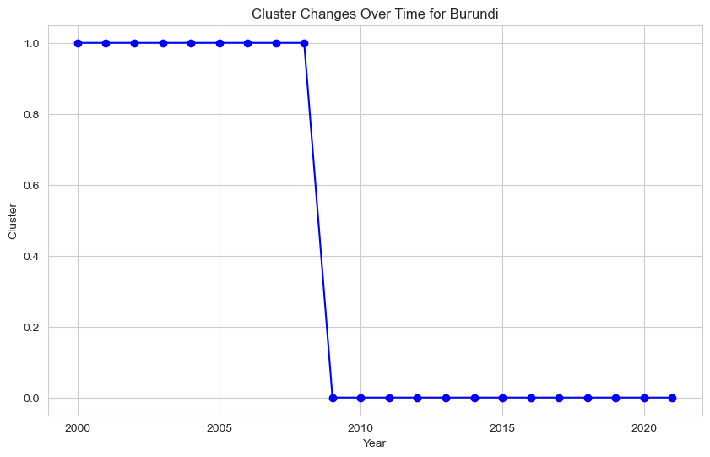
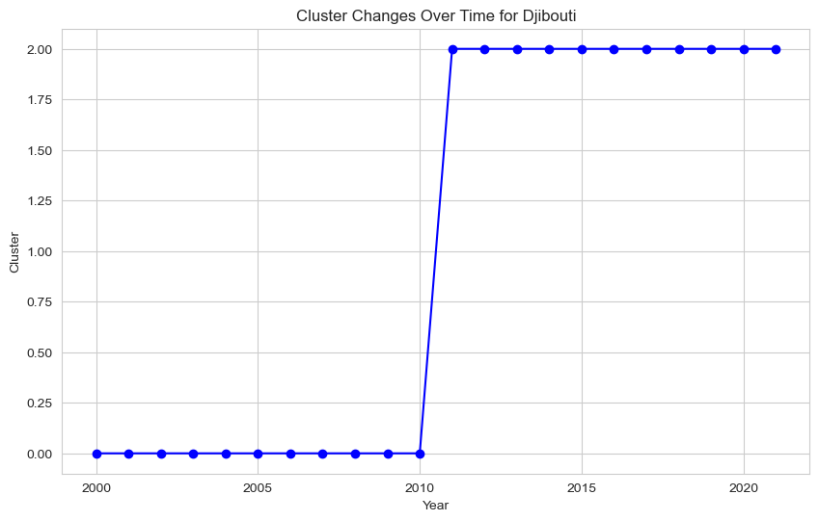
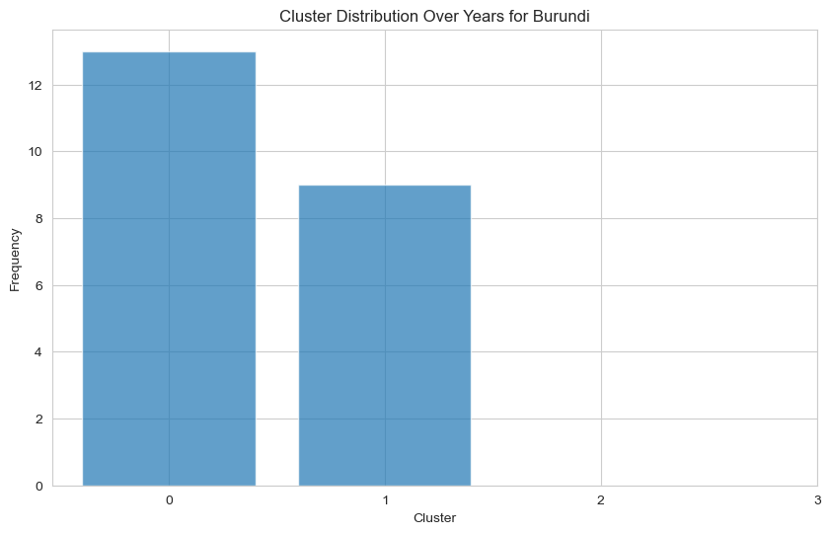
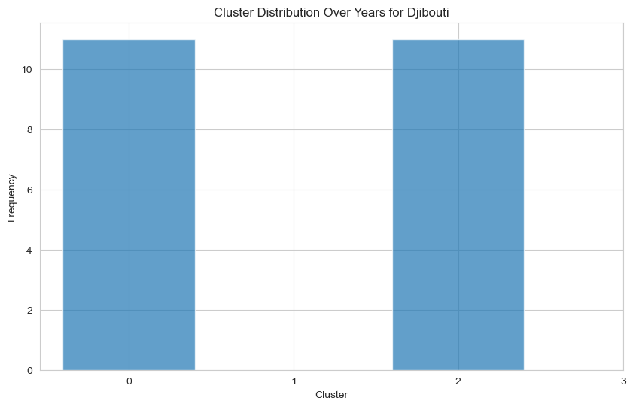

Slide 16
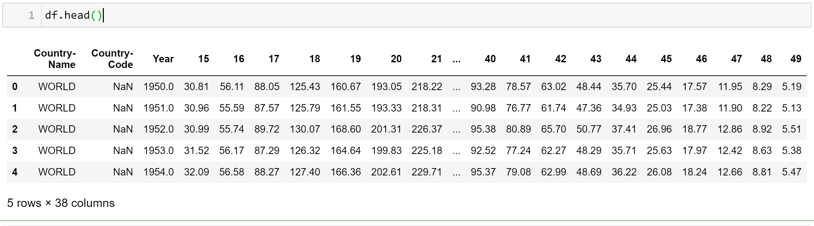
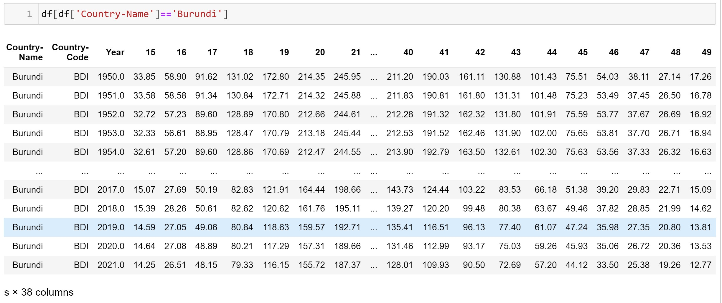

Slide 17
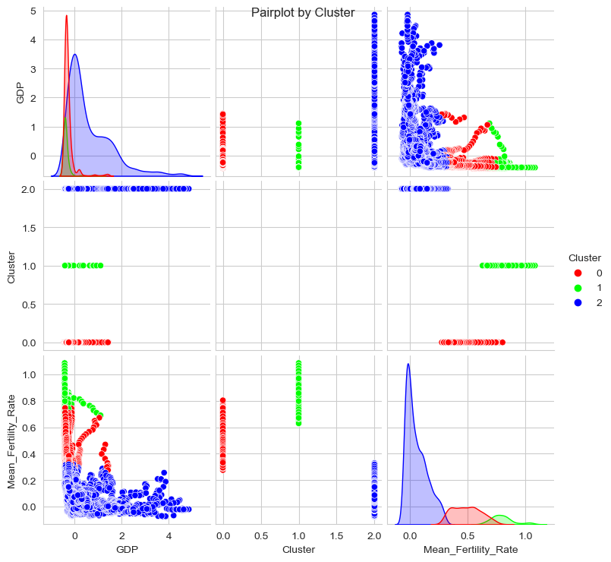

Slide 18
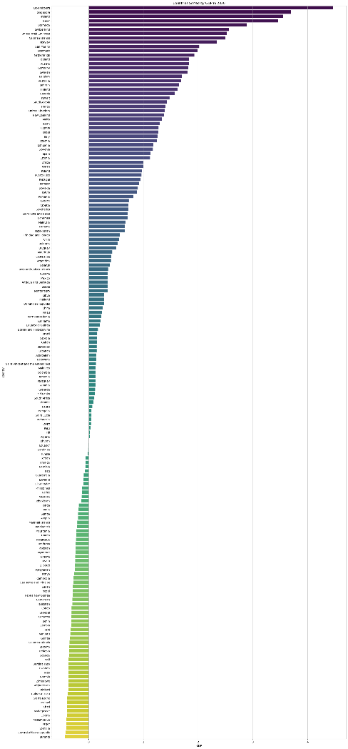
Countries Sorted by GDP

Slide 19
Country-Name | GDP
Luxembourg | 4.461621
Singapore | 3.702117
Ireland | 3.552122
Qatar | 3.460488
Bermuda | 2.892314
... | ...
Mozambique | -0.405628
Niger | -0.406440
Somalia | -0.410277
Central African Republic | -0.422593
Burundi | -0.428601

Slide 20
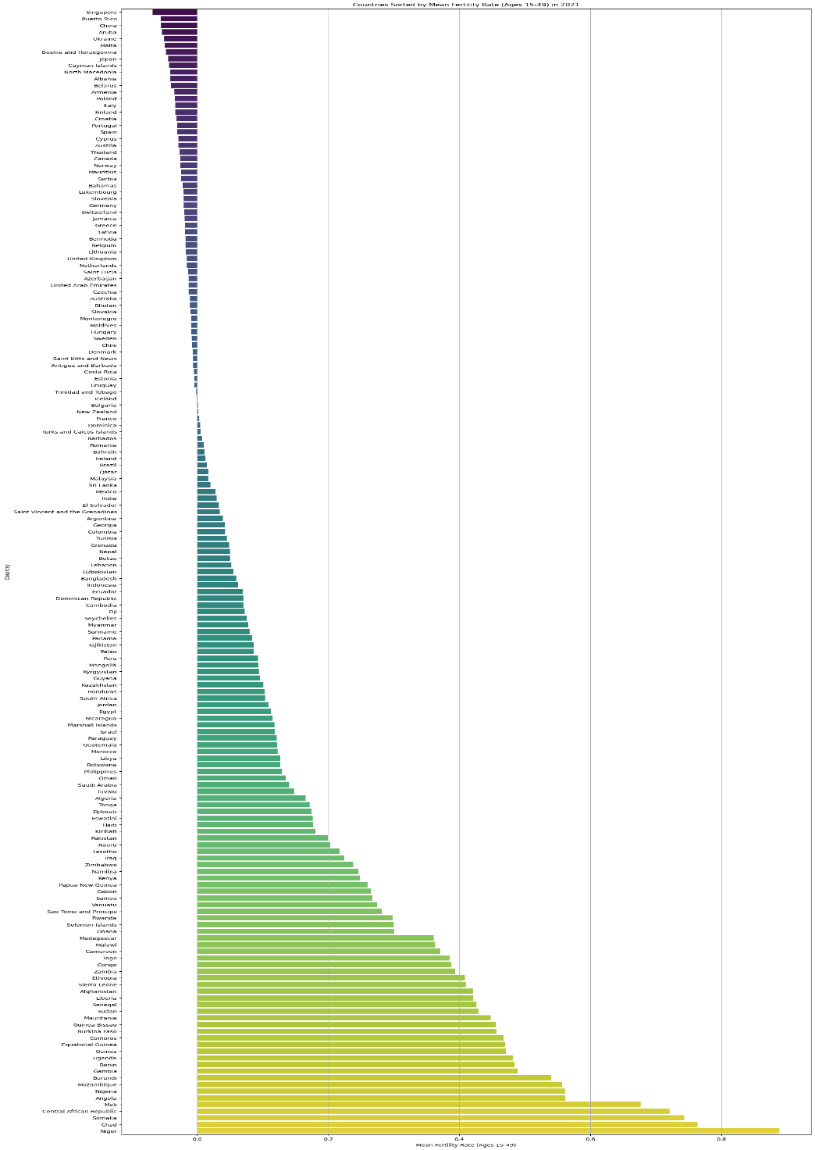
Countries Sorted by Mean Fertility Rate

Slide 21
Country-Name Mean_Fertility_Rate
Singapore -0.067808
Puerto Rico -0.055952
China -0.055002
Aruba -0.053726
Ukraine -0.050522
... ... ...
Mali 0.676765
Central African Republic 0.720943
Somalia 0.742975
Chad 0.763637
Niger 0.888797

Slide 22
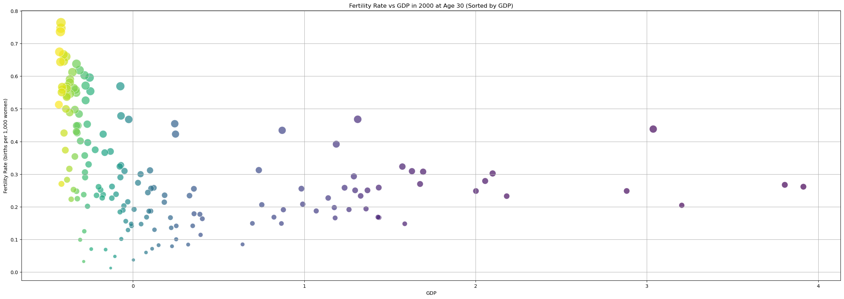
Fertility Rate vs GDP

Slide 23
Definitions:
The age-specific fertility rate (ASFR) "measures the annual number of births to women of a specified age or age group per 1,000 women in that age group."
Gross domestic product (GDP) per capita measures a country's economic output per person and is calculated by dividing the GDP of a country by its population.

Slide 24
References
The National Center for Biotechnology Information advances science and health by providing access to biomedical and genomic information. (NCBI) Link
Department of Economic and Social Affairs Population Division Link
THE NEW ECONOMICS OF FERTILITY Link
Our World in Data- Fertility rate Link
Our World in Data- GDP per Capita Link
UNICEF Data Monitoring the situation of children and women Link

Slide 25


Muchas Gracias Guapos!

